Slide 1
channel (subscriber and language)Dashboard2
File created on: 10/17/2023 12:26:53 PM

Slide 2
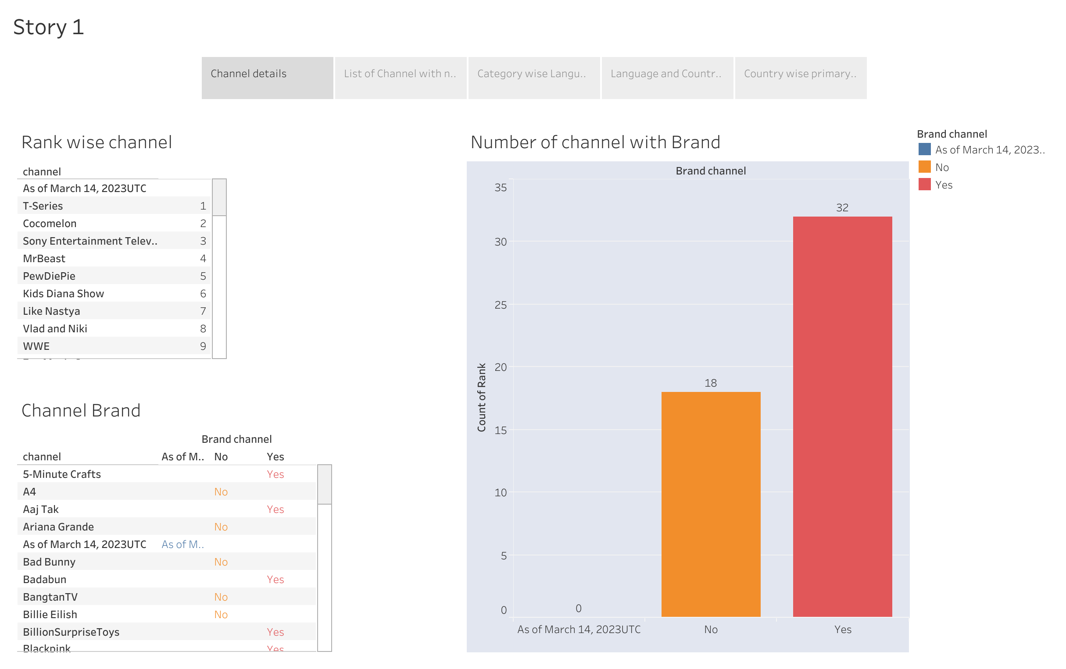

Slide 3
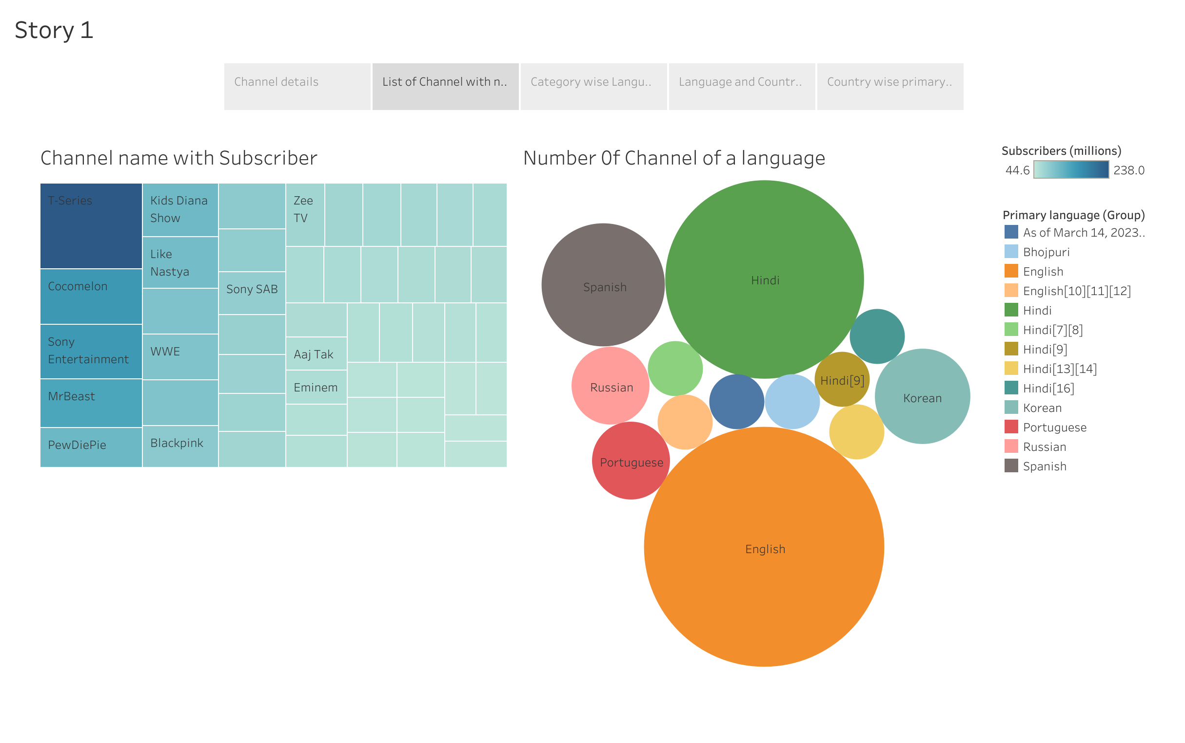

Slide 4
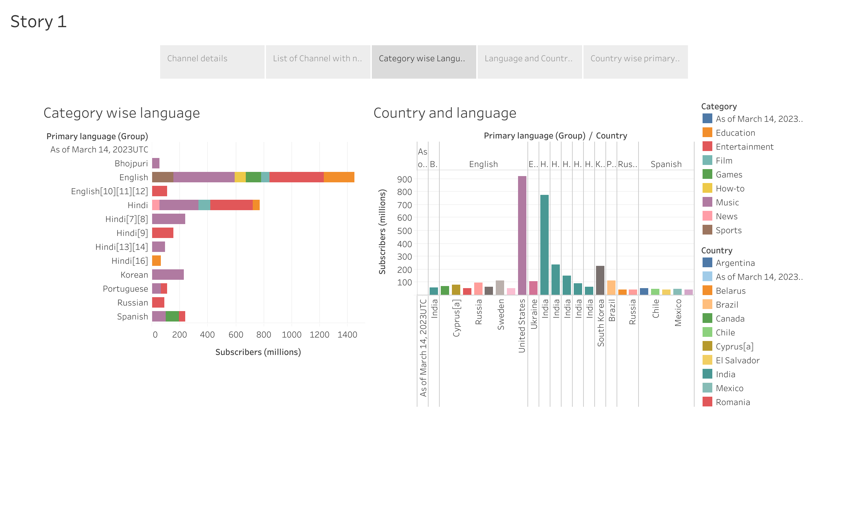

Slide 5
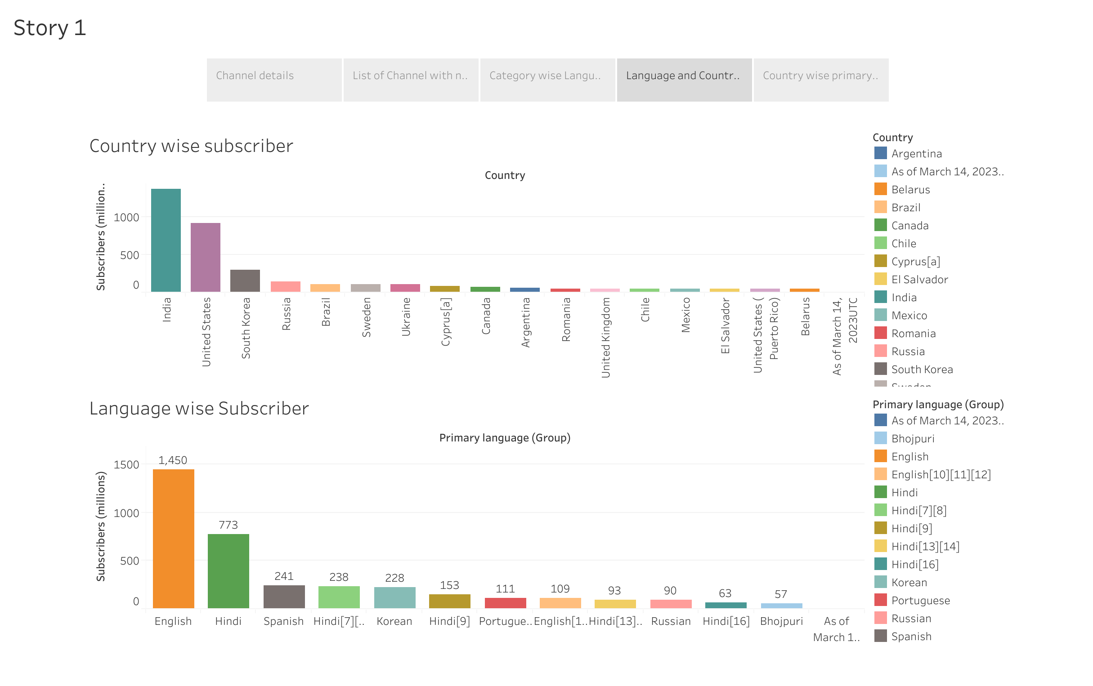

Slide 6
